Slide 1
Data Engineering in GCP
By
Abhishek Rajeevan
GitHub repo - retail_sales_analytics

Slide 2
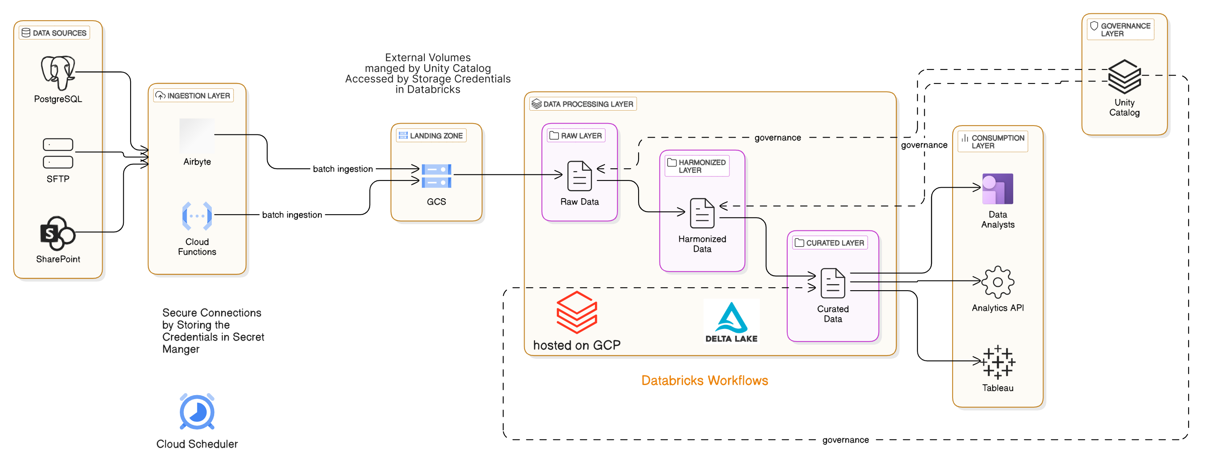
High Level Diagram

Slide 3
Components
Data Sources - Any source like SFTP, Databases, SharePoint etc.
Ingestion - Might be a push from Source team or pull with our Ingestion engine. Use any existing Ingestion frameworks if already available or we can write custom code and use it as Cloud functions.
Landing Zone - All the data is stored in GCS. Format should be efficient for storage. Can have multiple buckets and folder/sub folders under them to properly organize data.
Databricks - Use Databricks for Processing and as a Unified Analytics platform. Data will be stored in Delta format. We are using Databricks Asset Bundles for properly packaging the code and deploy it in Infrastructure as a Code method.
Consumption - Could be Dashboards, Data Analysts, APIs etc.
Access - Access to all resources will be only through Service Accounts in GCP. Access to external volumes in Databricks will be through Storage Credentials.
Scheduler - For everything in Databricks use Databricks workflows. For ingesting the data, try to use Databricks workflows itself, but if not use any light weight scheduler instead of heavy ones like Airflow.

Slide 4
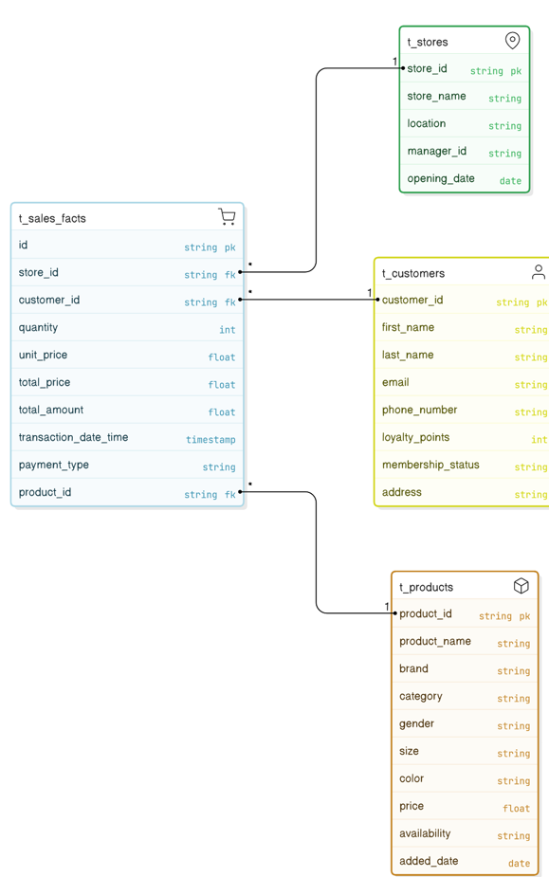
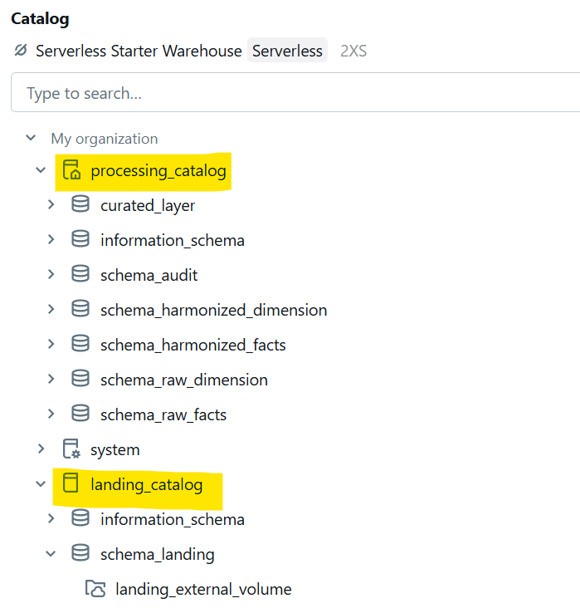
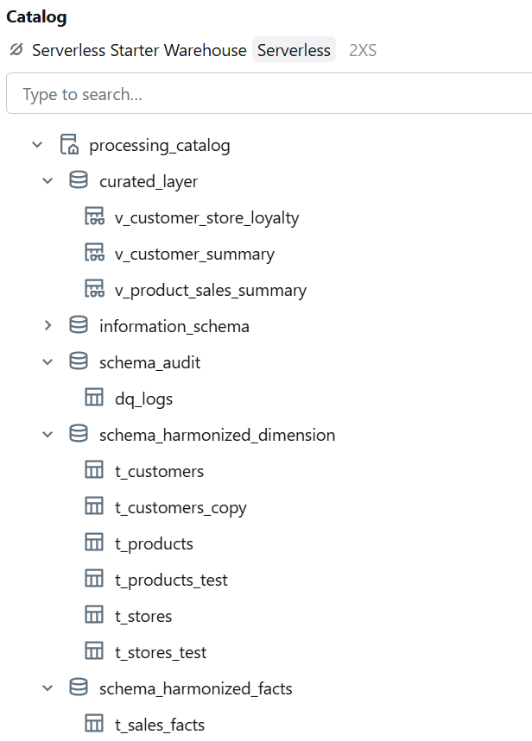

Data Modeling
GitHub -> retail_sales_analytics/data_modeling

Slide 5
Data Governance
Data Governance is done using Unity Catalog.
Create groups from the Admin Console (DataStewards, DataCosnumers etc)
Add member to the groups and give accesses at the group level and not the user level.
Properly add tags to the tables created. eg:- data_owner, sensitivity etc.
Write Data masking functions and use them to mask the sensitive columns based on the Roles (example only CRM team can see Phone number & email)
GitHub link - https://github.com/abhishekrajeevan/retail_sales_analytics/datagov

Slide 6
Future Improvements
Streaming data - Use Confluent Kafka as a streaming platform. In addition to using Kafka as a Message Broker. Use Kafka connect to seamlessly connect from Kafka to data sinks like BigQuery or Delta Tables
Data Quality - Currently I am using custom DQ checks in Databricks Notebooks while processing data from Raw to Harmonized layer. Adapt solutions like Great Expectation or PyDeequ.
GitHub integration -> Currently the code in GitHub is not connected to the platform via GitHub actions for CI/CD.
GitHub code - https://github.com/abhishekrajeevan/retail_sales_analytics
Improve the code base to make the workflows more dynamic and parameterized. Instead of having separate workflows for each dimension, parametrize them.

